Slide 1
Note 6
Complex SQL Queries, Schema Modification
CSC134
Spring 2022
Dr. Haiquan Chen

Slide 2

More Complex SQL
Meanings of NULL
  Unknown value
  Unavailable
  Not applicable
SQL allows queries that check whether an attribute value is NULL
  IS or IS NOT NULL

Slide 3
More Complex SQL
Writing nested queries using operator IN
  Use IN to write a subquery
Operator IN
  Check if a value is in a set
  Evaluates to TRUE if that is the case
  Syntax:
  SELECT column_name(s)
  FROM table_name
  WHERE column_name(s) IN (SELECT STATEMENT);

Slide 4

Nested Queries
All #’s of the projects managed by a employee whose last name is ‘’Smith”
OR combines the two Boolean conditions
All #’s of the projects having employee whose last name is ‘Smith’

Slide 5

Correlated Queries
If an inner query uses a table declared in outer query, such nested queries are called correlated queries
  The inner query evaluates once for each tuple in the table declared in the outer query.
Pass each EMPLOYEE tuple to the inner query for each iteration

Slide 6
Collapsing Nested Queries
In some cases, a nested query can be collapsed into one single block:
Q16 in the last slide can be re-written as:
Q16A: SELECT E.Fname, E.Lname
FROM EMPLOYEE AS E, DEPENDENT AS D
WHERE E.Ssn=D.Essn AND E.Sex=D.Sex
AND E.Fname=D.Dependent_name;

Slide 7

Nested Queries
Operator IN also supports tuple (multiple columns)
  Place them within parentheses
  Find SSNs of the employees who work on the same project as the employee with the SSN 123456789 with the same hours

Slide 8

ANY and ALL
ANY,ALL with >, >=, <, <=, and != compare a single value with a set
  For example,
    > ANY Returns TRUE if a value is greater than some value in the set
    > ALL Returns TRUE if a value is greater than all values in the set
What if ANY?

Slide 9
EXISTS and UNIQUE: Built-in Functions
SQL functions EXISTS(Q) and NOT EXISTS(Q)
  As Boolean operators
  Check whether a query result is empty set or not
SQL function UNIQUE(Q)
  Returns TRUE if there are no duplicate tuples in a query result

Slide 10

USE of EXISTS
What is the meaning of the following SQL?
SELECT E.Fname, E.Lname
FROM Employee E
WHERE EXISTS (SELECT *
FROM DEPENDENT DEP
WHERE E.Ssn= DEP.Essn)
AND EXISTS (SELECT *
FROM Department D
WHERE E.Ssn= D.Mgr_Ssn)

Slide 11

Use IN with Explicit Values
Use explicit values in IN to replace a nested query
  Retrieve the social #’s of all the employees who work on the project 1, 2 or 3.
Q17: SELECT DISTINCT Essn
FROM WORKS_ON
WHERE Pno IN (1, 2, 3);
What if I change OR to AND in the questions?
  Use set operators! UNION, INTERSECT, EXCEPT

Slide 12
More examples about IN
https://www.w3schools.com/sql/sql_in.asp

Slide 13
Aggregate Functions in SQL
Aggregate Functions
  Built-in functions which can summarize information for a set of tuples
  Five functions COUNT,SUM, MAX, MIN, and AVG
  Aggregate functions ignore NULL values

Slide 14

Aggregate Functions in SQL
This query returns a single row of computed values from EMPLOYEE table:
SELECT MAX (Salary), AVG(Salary), COUNT(Salary)
FROM EMPLOYEE
(DISTINCT Salary)
MAX(Salary) | AVG(Salary) | COUNT(Salary)
… | … | …

Slide 15
Aggregate Functions in SQL
Us AS to change the display name of a column:
SELECT SUM (Salary) AS Total_Sal, MAX (Salary) AS Highest_Sal, MIN (Salary) AS Lowest_Sal, AVG (Salary) AS Average_Sal
FROM EMPLOYEE;
Total_Sal | Highest_Sal | Lowest_Sal | Average_Sal
… | … | … | …

Slide 16
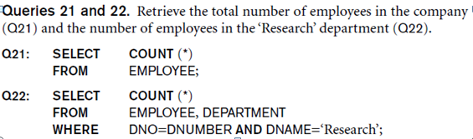
Aggregate Functions in SQL
* denotes every column in a table

Slide 17
More examples
https://www.w3schools.com/sql/sql_min_max.asp

Slide 18
The GROUP BY Clause
Apply aggregate functions to a subset of tuples.
  Using GROUP BY clauses
  Each aggregate function applies to each tuple group independently
  Syntax: GROUP BY grouping attributes
If NULL exists in a grouping attribute
  A separate group is created for all tuples with this NULL value

Slide 19
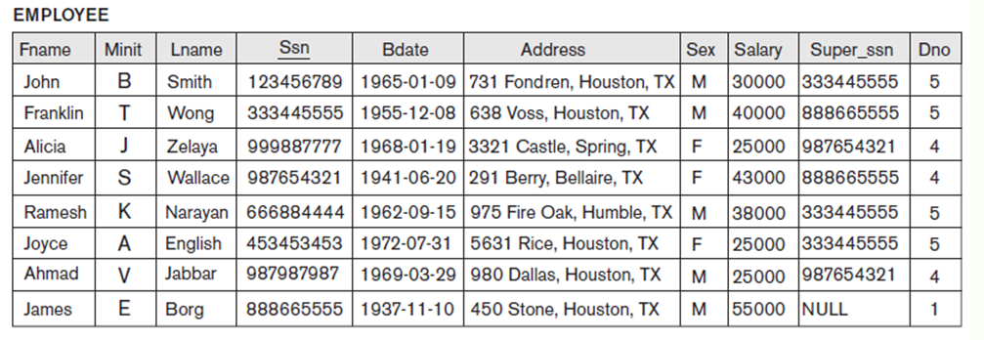
The GROUP BY Clause
An example of grouping:
  SELECT Dno, MAX (Salary), AVG(Salary), COUNT(Salary)
  FROM EMPLOYEE
  GROUP BY Dno

Slide 20
More examples
https://www.w3schools.com/sql/sql_groupby.asp

Slide 21
The HAVING Clause
HAVING clause allows you to specify a condition to select or reject a group
    SELECT Dno, MAX (Salary), AVG(Salary), COUNT(Salary)
    FROM EMPLOYEE
    GROUP BY Dno
    HAVING COUNT(Ssn) > 2

Slide 22
Another Example: The GROUP BY and HAVING
Query 26. For each project on which more than two employees work, retrieve the project number, the project name, and the number of employees who work on the project.
Q26: SELECT P.Pnumber, P.Pname, COUNT (*)
FROM PROJECT P, WORKS_ON W
WHERE P.Pnumber = W.Pno
GROUP BY P.Pnumber
HAVING COUNT (*) > 2;

Slide 23
More examples
https://www.w3schools.com/sql/sql_having.asp

Slide 24
Note: WHERE vs HAVING
The WHERE clause applies to attributes, or to say, individual tuples
The HAVING clause applies to tuple groups, or to say, aggregate functions, and should be always used together with GROUP BY clause

Slide 25
Note: Aggregate Functions
Aggregate functions can ONLY be used in the SELECT or HAVING clause!!!

Slide 26
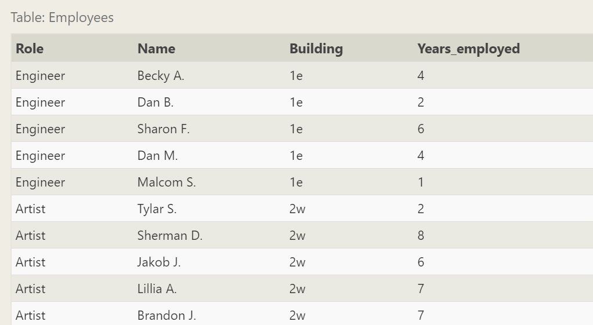
In-class Practice: Employee data at a film studio
… … … …

Slide 27
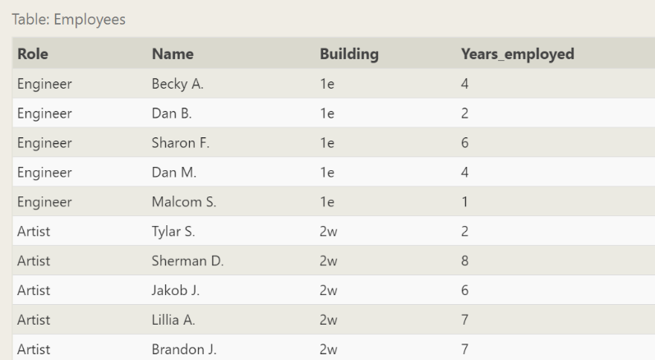
In-class Practice
Use SQL to write the following queries:
1) Find the longest time that an employee has been at the studio
  SELECT MAX(years_employed) as Max_years_employed
  FROM employees;

Slide 28
In-class Practice:
2) For each role, find the average number of years employed by employees in that role
  SELECT role, AVG(years_employed) as Average_years_employed
  FROM employees
  GROUP BY role;

Slide 29
In-class Practice
3) Find the total number of employee years worked in each building
SELECT building, SUM(years_employed) as Total_years_employed
FROM employees
GROUP BY building;

Slide 30
In-class Practice
4) Find the number of Artists in the studio
SELECT role, COUNT(*) as Number_of_artists
FROM employees
WHERE role = "Artist";

Slide 31
In-class Practice
5) Find the number of Employees of each role in the studio
SELECT role, COUNT(*)
FROM employees
GROUP BY role;

Slide 32
In-class Practice
6) Find the total number of years employed by all Engineers
SELECT role, SUM(years_employed)
FROM employees
WHERE role = "Engineer";
SELECT role, SUM(years_employed)
FROM employees
GROUP BY role
HAVING role = "Engineer";

Slide 33

EXPANDED Block Structure of SQL Queries

Slide 34
Query order of execution
FROM
  The FROM clause is first executed
WHERE
  Then WHERE constraints are applied to the individual rows.
GROUP BY
  The remaining rows after the WHERE constraints are then grouped
HAVING
  HAVING clause discard the grouped rows that don't satisfy the constraint.
SELECT
  Any expressions in the SELECT are computed
DISTINCT
  Of the remaining rows, rows with duplicate values in the column marked as DISTINCT will be discarded
ORDER BY
  The remaining rows are then sorted.

Slide 35
Schema Change Statements in SQL
Database Schema can be changed over time

Slide 36
The ALTER TABLE Command
ALTER TABLE includes:
  Adding or dropping a column or a constraint
    ALTER TABLE EMPLOYEE ADD [COLUMN] Job VARCHAR(12);
  To drop a column, drop behavior options must be specified:
    CASCADE (other tables may also be updated to ensure data consistency)
    RESTRICT (rejected if any constraint violations)
    ALTER TABLE EMPLOYEE DROP [COLUMN] Job CASCADE;

Slide 37

The ALTER TABLE Command
Add a Constraint:
  ALTER TABLE Employee
  ADD CONSTRAINT fk_Dno
  FOREIGN KEY (Dno)
  REFERENCES Department (Dnumber)
Drop constraints
  Drop a named constraint

Slide 38
Demo
https://www.w3schools.com/sql/sql_alter.asp

Slide 39
The DROP TABLE Command
DROP TABLE command
  Used to drop tables
Drop behavior options must be specified:
  CASCADE (other tables may also be updated to ensure data consistency)
  RESTRICT (rejected if any constraint violations): Default
Example:
  DROP TABLE EMPLOYEE;
  DROP SCHEMA COMPANY;
Difference between Delete and Drop?

Slide 40
How DBs handle time
Databases have data types for storing a date or a datetime:
MySQL data types:
  DATE - format YYYY-MM-DD
  DATETIME - format: YYYY-MM-DD HH:MI:SS
  TIMESTAMP - format: YYYY-MM-DD HH:MI:SS
  YEAR - format YYYY or YY
When working with dates, ensure that date format used in your query matches the date format in the database.
You can compare two dates easily:

Slide 41
Demo
https://www.w3schools.com/sql/sql_dates.asp

Slide 42
Where to Find More SQL Examples?
https://www.w3schools.com/sql/default.asp
https://sqlzoo.net/wiki/SQL_Tutorial
https://www.w3resource.com/sql-exercises/

Slide 43
SQL In-class Practice
Worksheets 2 and 3

Slide 44
Video on Correlated Queries
A inner query uses a table defined in the outer query

